Slide 1

SELECT PREPARE AND SERVE VARIOUS CHEESES
D1.HCC.CL2.21
Notes:
Trainer welcomes trainees to class.

Slide 2
Select prepare and serve various cheeses
This Unit comprises four elements:
1
Select supplier to purchase cheese and equipment
2
Prepare cheese for service
3
Present cheese
4
Store cheese
Notes:
Trainer advises students this Unit comprises four Elements, as listed on the slide explaining:
Each Element comprises a number of Performance Criteria which will be identified throughout the class and explained in detail
Students can obtain more detail from their Trainee Manual
The course presents advice and information but where their workplace requirements differ to what is presented, the workplace practices and standards must be observed.

Slide 3

Select prepare and serve various cheeses
Assessment for this Unit may include:
Oral questions
Written questions
Work projects
Workplace observation of practical skills
Practical exercises
Formal report from employer/supervisor.
Notes:
Trainer advises students that assessment for this Unit may take several forms all of which are aimed at verifying they have achieved competency for the Unit as required.
Trainer indicates to students the methods of assessment that will be applied to them for this Unit.

Slide 4
Select prepare and serve various cheeses
Identify and select suppliers for purchasing of products.
Element 1: Select supplier to purchase cheese and equipment
Identify cheese varieties required by the enterprise.
Notes:
Trainer to discuss
Performance criteria relating to Element 1
Identify and select suppliers for purchasing of products
Identify cheese varieties required by the enterprise

Slide 5

Select supplier
Indentify and select supplier
Is the supplier able to provide the quality required?
Quality of cheese
Consistency of supply.
Is the establishment able to meet supplier requirements?
Order enough product
Meet payment requests on time.
Notes:
Trainer to discuss
What is the quality of cheese required by the establishment requirements?
The range of products that the supplier has to offer?
How regular the supply is available?
How often the supplier can deliver to the establishment?
The cost of the product from the supplier to the establishment.

Slide 6

Select supplier
Indentify cheese varieties
Fresh un-ripened:
Cherve from goats milk
Ricotta from cow or goats milk.
Stretched curd:
Mozzarella.
White mould (mould on outside of cheese):
Brie
Camembert.
Notes:
Trainer to discuss

Slide 7
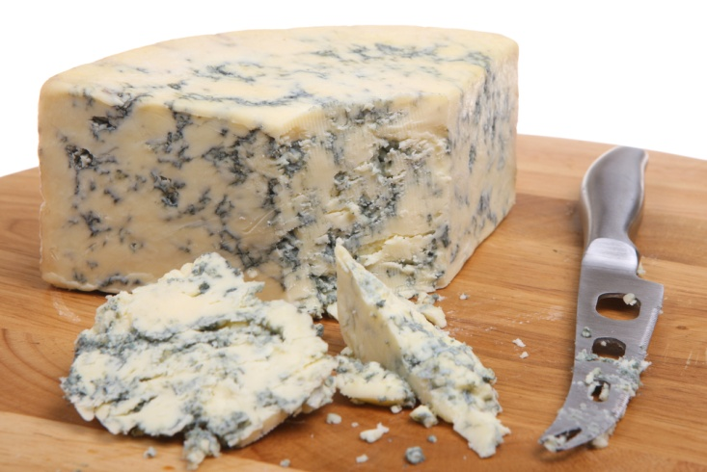
Select supplier
Indentify cheese varieties
Blue mould (mould on inside):
Stilton – English
Gorgonzola – Italian
Brie style.
Washed rind (washed in brine, orange sticky on outside):
Tilsit
Soft style brie-like.
Notes:
Trainer to discuss

Slide 8

Select supplier
Indentify cheese varieties
Semi Hard eye Cheeses:
Edam
Gouda
Gruyere.
Washed rind (washed in brine, orange sticky on outside):
Tilsit
Soft style brie like.
Notes:
Trainer to discuss

Slide 9

Select supplier
Indentify cheese varieties
Cheddar – English classic:
Cheshire
Red leister
Colby.
Hard Cheeses:
Parmesan
Pecorino.
Notes:
Trainer to discuss

Slide 10
Select prepare and serve various cheeses
Bring product to appropriate serving temperature.
Element 2: Prepare cheese for service
Use correct preparation equipment safely.
Prepare required garnishes and accompaniments to compliment service style.
Notes:
Trainer to discuss
Bring product to appropriate serving temperature
Use correct preparation equipment safely
Prepare required garnishes and accompaniments to compliment service style

Slide 11

Prepare cheese for service
Bring product to appropriate serving temperature
Allow to come to room temperature slowly
Protect from outside contamination
Do not dry surface of cheese.
Notes:
Trainer to discuss
Hygiene requirements

Slide 12

Prepare cheese for service
Use correct preparation equipment safely
All cutting implements must be
Clean
Suitable to the job.
Notes:
Trainer to discuss

Slide 13
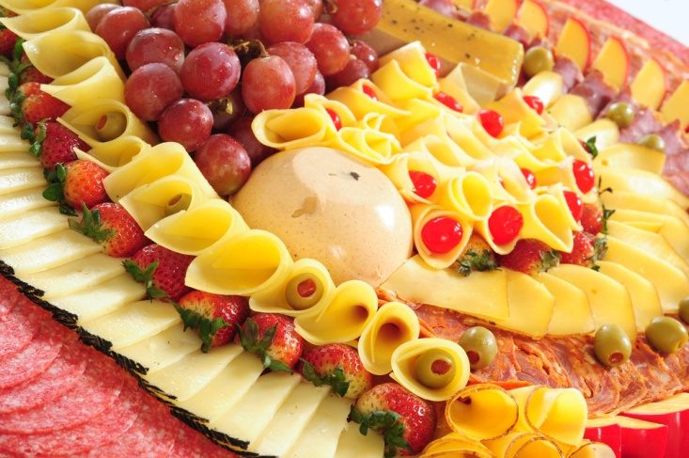
Prepare cheese for service
Prepare required garnishes and accompaniments
Plan what is required
It must compliment the cheese
Should dominate the cheese.
Notes:
Trainer to discuss

Slide 14
Select prepare and serve various cheeses
Present cheese to enterprise standards.
Element 3: Present cheese
Decorate cheese with complimentary garnishes and accompaniments.
Notes:
Trainer to discuss:
Present cheese to enterprise standards
Decorate cheese with complimentary garnishes and accompaniments

Slide 15

Present cheese
Present cheese to enterprise standards
Platter of plate
Ceramic or wood
Single or mixed.
Notes:
Trainer to discuss

Slide 16

Present cheeses
Decorate cheese with garnishes and accompaniments
Do not bury the cheese under A LOT of extras:
Fruit:
Dried
Fresh
Bread:
Plain
Fruited
Nutted
Crackers:
Plain
Seasoned
Sauce.
All can be included or just one?
Notes:
Trainer to discuss

Slide 17
Select prepare and serve various cheeses
Minimize wastage through correct purchasing practices
Minimize wastage through correct storage practices
Element 4: Store cheese
Apply appropriate hygiene standards in the storage and handling of cheese.
Access and use cheese leftovers appropriately.
Notes:
Trainer to discuss
Minimize wastage through correct purchasing practices
Minimize wastage through correct storage practices
Apply appropriate hygiene standards in the storage and handling of cheese
Access and use cheese leftovers appropriately

Slide 18
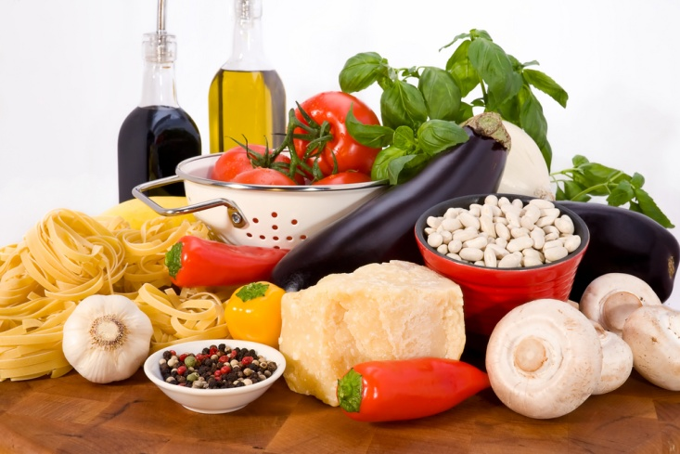
Store cheese
Minimise wastage through correct purchasing
Only what is required
Smaller unit sizes
Emergency supply.
Notes:
Trainer to discuss:
Minimize wastage through correct purchasing practices
Plan what is to be sold?
Hard to do, cheese keeps well, not like fresh fish.
Have some reserve

Slide 19

Store cheese
Minimise wastage through correct storage
keep chilled
Covered
Away from strong odours
Re-wrap securely to prevent drying
Warp securely to prevent mould growing
Check regularly, daily.
Notes:
Trainer to discuss
Minimize wastage through correct storage practices

Slide 20

Store cheese
Apply appropriate hygiene standards
Handle with clean hands
Cut with clean utensils
Store in clean food safe containers
Re-wrap securely to avoid air drying.
Notes:
Trainer to discuss
Apply appropriate hygiene standards in the storage and handling of cheese

Slide 21

Store cheese
Access and use leftovers
Utilise broken pieces in other cooking:
Sauces
Biscuits
Cakes.
First in first out
Notes:
Trainer to discuss
Access and use cheese leftovers appropriately

Slide 22
Congratulations! You’ve completed ‘Select prepare and serve various cheeses’ unit
Notes:
At the end of this training session trainer congratulates trainees on its completion.

